Slide 1
Building the System

Slide 2
Advantages of using Linux in embedded systems.
The main advantage of Linux is the ability to reuse components.
Linux provides scalability due to its modularity and configurability.
Open source. No royalties or licensing fees.
Ported to a broad range of hardware architectures, platforms and devices.
Broad support of applications and communication protocols (e.g., TCP/IP stack, USB stack, graphical toolkit libraries).
Large support from an active community of developer

Slide 3
The main components of a Linux embedded system
Bootloader
Kernel
System call interface
C-Runtime library
System shared libraries
Root filesystem.

Slide 4
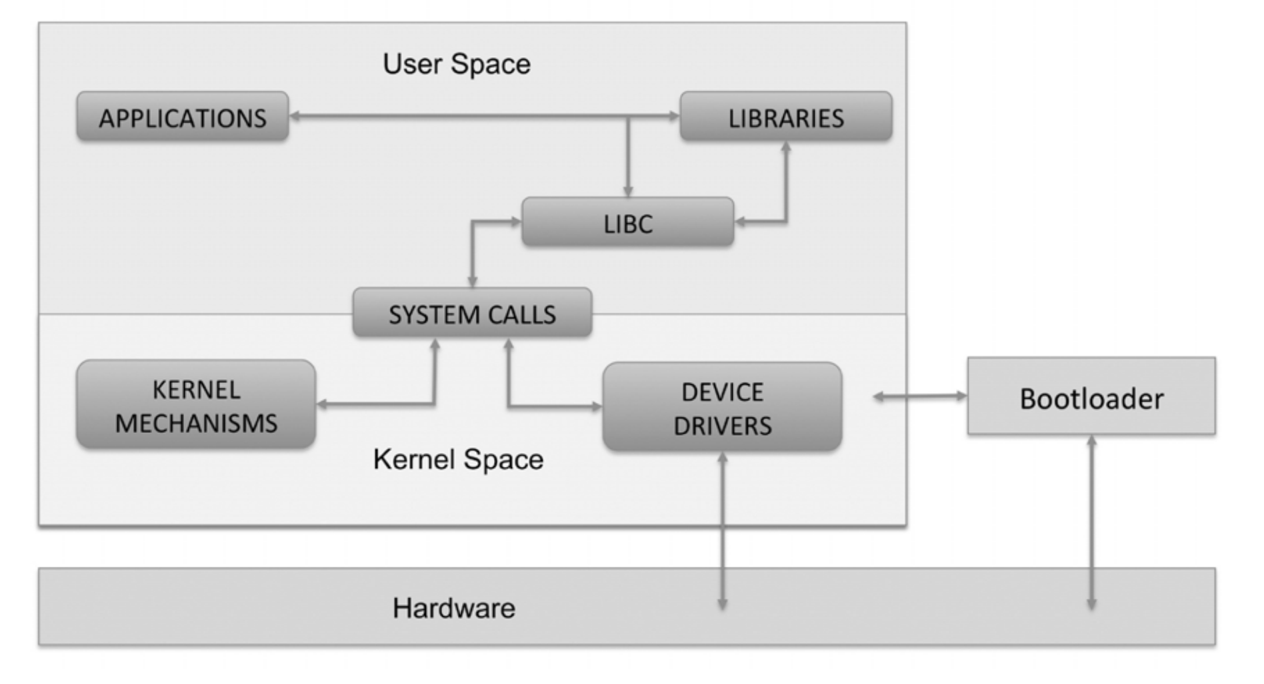

Slide 5
Bootloader
Linux cannot be started in an embedded device without a small amount of machine specific code to initialize the system. Linux requires the bootloader code to do very little, although several bootloaders do provide extensive additional functionality. The minimal requirements are:
Configuration of the memory system.
Loading of the kernel image and the device tree at the correct addresses.
Optional loading of an initial RAM disk at the correct memory address.
Setting of the kernel command-line and other parameters (e.g, device tree, machine type)
There are different bootloader options that come in all shapes and sizes. U-Boot is the standard bootloader for ARM Linux. The U-Boot Mainline is located at http://git.denx.de/u-boot.git and there is a dedicated page on U-Boot wiki at http://www.denx.de/wiki/U-Boot/SourceCode.

Slide 6
Main U-Boot features:
Small: U-Boot is a bootloader, i.e. its primary purpose in the system is to load an operating system. That means that U-Boot is necessary to perform a certain task, but it is not worth spending significant resources on. Typically U-Boot is stored in the relatively small NOR flash memory, which is expensive compared to the much larger NAND devices normally used to store the operating system and the application. An usable and useful configuration of U-Boot, including a basic interactive command interpreter, support for download over Ethernet and the capability to program the flash should fit in no more than 128 KB. Fast: The end user is not interested in running U-Boot. In most embedded systems they are not even aware that U-Boot exists. The user wants to run some application code, and they want to do that as soon as possible after switching on the device. Initialize devices only when they are needed within U-Boot, i.e. don't initialize the Ethernet interface(s) unless U-Boot performs a download over Ethernet; don't initialize any IDE or USB devices unless U-Boot actually tries to load files from these, etc.

Slide 7
Main U-Boot features:
Portable: U-Boot is a bootloader, but it is also a tool used for board bring-up, for production testing, and for other activities that are very closely related to hardware development. So far, it has been ported to several hundreds of different boards on about 30 different processor families
Configurable: U-Boot is a powerful tool with many, many extremely useful features. The maintainer or user of each board will have to decide which features are important and what shall be included with their specific board configuration to meet the current requirements and restrictions
Debuggable: U-Boot is not only a tool in itself, it is often also used for hardware bring-up, so debugging U-Boot often means that you don't know if you are tracking down a problem in the U-Boot software or in the hardware you are running on. Code that is clean and easy to understand and debug is all the more important to everyone. One important feature of U-Boot is to enable output to the (usually serial) console as soon as possible in the boot process, even if this causes tradeoffs in other areas like memory footprint. All initialization steps shall print some "begin doing this" message before they actually start, and some"done" message when they complete. For example, RAM initialization and size detection may print a "RAM: " before they start, and "256 MB\n" when done. The purpose of this is that you can always see which initialization step was running if any problems occur. This is important not only during software development, but also for the service people dealing with broken hardware in the field. U-Boot should be debuggable with simple JTAG or BDM equipment. It should use a simple, single-threaded execution mode

Slide 8

Linux Kernel
Multitasking, virtual memory, shared libraries, demand loading, shared copy-on-write executables, proper memory management, and multistack networking including IPv4 and IPv6.
It is charged with managing the hardware, running user programs, and maintaining the overall security and integrity of the whole system
As kernels move from the mainline into the stable category, two things can happen: 1. They can reach End of Life after a few bugfix revisions, which means that kernel maintainers will release no more bugfixes for this kernel version, or 2. They can be put into longterm maintenance, which means that maintainers will provide bugfixes for this kernel revision for a much longer period of time.

Slide 9
Some of the subsystems the kernel is comprised of are listed below:
• /arch/<arch>: Architecture specific code • /arch/<arch>/<mach>: Machine/board specific code • /Documentation: Kernel documentation. Do not miss it! • /ipc: Inter process communication • /mm: Memory management • /fs: File systems • /include: Kernel headers • /include/asm-<arch>: Architecture and machine dependent headers • /include/linux: Linux kernel core headers • /init: Linux initialization (including main.c) • /block: Kernel block layer code • /net: Networking functionality • /lib: Common kernel helper functions • /kernel: Common Kernel structures • /arch: Architecture specific code • /crypto: Cryptography code • /security: Security components • /drivers: Built-in drivers (does not include loadable modules) • Makefile: Top Linux makefile (sets arch and version) • /scripts: Scripts for internal or external us

Slide 10
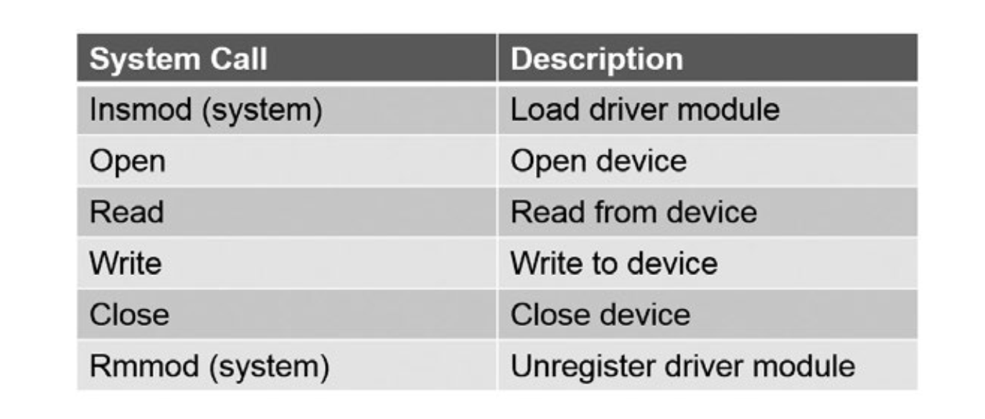
System Call Interface
The system call is the fundamental interface between an application and the Linux kernel. System calls are the only means by which an user space application can interact with the kernel. In other words, they are the bridge between user space and kernel space. The strict separation of user and kernel space ensures that user space programs cannot freely access kernel internal resources, thereby ensuring the security and stability of the system. The system calls elevate the privilege of the user process.

Slide 11
C Runtime Library
The C runtime library (C-standard library) defines macros, type definitions and functions for string handling, mathematical functions, input/output processing, memory allocation and several other functions that rely on OS services. The runtime library provides applications with access to OS resources and functions by abstracting the OS System call interface.
Several C runtime libraries are available: glibc, uClibc, eglibc, dietlibc, newlib. The choice of the C library must be made at the time of the cross-compiling toolchain generation, as the GCC compiler is compiled against a specific C library. The GNU C library, glibc, is the default C library used for example in the Yocto project. The GNU C Library is primarily designed to be a portable and high performance C library. It follows all relevant standards including ISO C11 and POSIX.1-2008. It is also internationalized and has one of the most complete internationalization interfaces known. You can find the glibc manual at https:// www.gnu.org/software/libc/manual/

Slide 12
System Shared Libraries
System shared libraries are libraries that are loaded by programs when they start. When a shared library is installed properly, all programs that start afterwards automatically use the new shared library. System shared libraries are typically linked with an user space application to provide it access to a specific system functionality. This system functionality can be either self-contained like compression or encryption algorithms or require access to underlying kernel resources or hardware. In the latter case the library provides a simple API that abstracts the complexities of the kernel or direct driver access.
System shared libraries encapsulate system functionality and therefore are an essential building block when building applications that interact with the system. Libraries are placed in the following standard root filesystem locations: • /lib: Libraries required for startup • /usr/lib: Most system libraries • /usr/local/lib: Non-system libraries

Slide 13
Root Filesystem
The root filesystem is where all the files contained in the file hierarchy (including device nodes) are stored. The root filesystem is mounted as /, containing all the libraries, applications and data

Slide 14
A Linux embedded root filesystem usually includes the following
/bin: Commands needed during bootup that might be used by normal users (probably after bootup).
/sbin: Like /bin, but the commands are not intended for normal users, although they may use them if necessary and allowed; /sbin is not usually in the default path of normal users, but will be in root's default path.
/etc: Configuration files specific to the machine.
/home: Like My Documents in Windows.
/root: The home directory for user root. This is usually not accessible to other users on the system.
/lib: Essential shared libraries and kernel modules.
/dev: Device files. These are special virtual files that help the user interface with the various devices on the system.
/tmp: Temporary files. As the name suggests, programs running often store temporary files in here.
/boot: Files used by the bootstrap loader. Kernel images are often kept here instead of in the root directory. If there are many kernel images, the directory can easily grow too large, and it might be better to keep it in a separate filesystem.
/mnt: Mount point for mounting a filesystem temporarily.
/opt: Add-on application software packages.
/usr: Secondary hierarchy.
/var: Variable data.
/sys: Exports information about devices and drivers from the kernel device model to user space, and is also used for configuration.
/proc: Represent the current state of the kerne

Slide 15
Linux Boot Process(1/3)
1. The boot process begins at POR (Power On Reset) where the hardware reset logic forces the ARM core to begin execution starting from the on-chip boot ROM. The boot ROM can support several devices (e.g, NOR flash, NAND Flash, SD/eMMC). In the i.MX7D processor the on-chip boot ROM sets up the DDR memory controller. The DDR technology is a potential key difference between different boards. If there is a difference in the DDR technology, the DDR initialization needs to be ported. In the i.MX7D the DDR initialization is coded in the DCD table, inside the boot header of the U-Boot image. The DCD (device configuration data) feature allows boot ROM code to obtain SoC configuration data from an external bootloader residing on the boot device. As an example, DCD can be used to program the DDR controller for optimal settings improving the boot performance. After setting up the DDR controller the boot ROM loads the U-Boot image to external DDR and runs it.

Slide 16
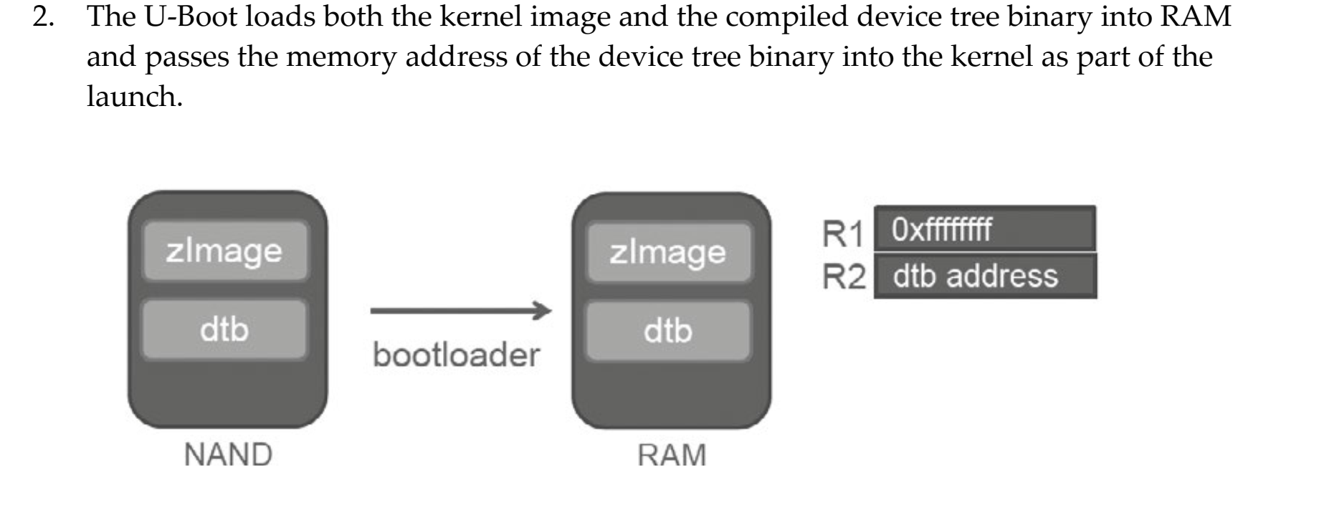
Linux Boot Process (2/3)

Slide 17
Linux Boot Process (3/3)
3. The U-Boot jumps to the kernel code 4. Kernel runs low level kernel initialization, enabling MMU and creating the initial table of memory pages, and setting up caches. This is done in arch/arm/kernel/head.s. The file head.s contains CPU architecture specific but platform independent initialization code. Then the system switches to the non architecture specific kernel startup function start_kernel().
5. Kernel runs start_kernel() located in init/main.c that: • Initializes the kernel core (e.g., memory, scheduling, interrupts, …). • Initializes statically compiled drivers. • Mounts the root filesystem based on bootargs passed to the kernel from U-Boot. • Executes the first user process, init. The process init, by default, is /init for initramfs, and /sbin/init for a regular filesystem. The three init programs that you usually find in Linux embedded devices are BusyBox init, System V init, and systemd. If System V is used, then the process init reads its configuration file, /etc/inittab, and executes several scripts that perform final system initialization

Slide 18
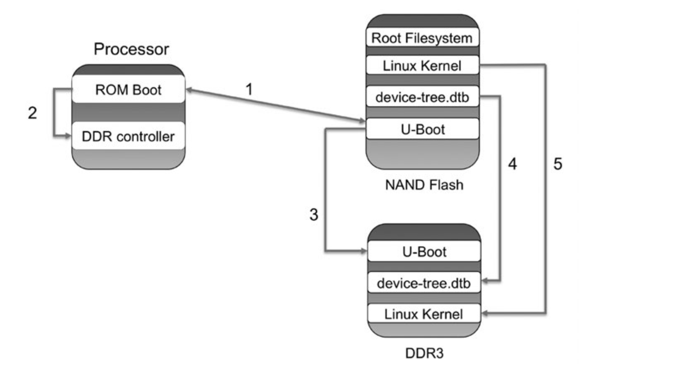
Diagram

Slide 19
Building a Linux Embedded System
Select a cross toolchain. The toolchain is the starting point for the development process, as it is used to build all subsequent software packages. The toolchain consists of the following parts: Assembler, Compiler, Linker, Debugger, Runtime Libraries and Utilities. A cross compiler is a compiler capable of creating executable code for a platform other than the one on which the compiler is running.
Select the different packages that will run on the target (Bootloader, Kernel and Root filesystem).
Configure and build these packages.
Deploy them on the device.

Slide 20
Several different ways to build an embedded linux system:
Manually (creating your own scripts): this option gives you total control, but it is also tedious and harder to reproduce builds on other machines. It also requires a good understanding of the software component installation process. For example, create a root filesystem from the ground up by yourself means: • Download the source code of all software components (libraries, utilities, or applications). • Solve all dependencies and version conflicts and apply patches. • Configure each software component. • Cross-compile each software component. • Install each software component.
Using complete distributions (e.g., Ubuntu/Debian): easy to get started, but harder to customize. A Linux distribution is a preselected kernel version and a root filesystem with a preselected set of libraries, utilities and applications.
Using Build frameworks (e.g., Buildroot, Yocto): This option allows you to customize and reproduce builds easily. This is becoming the most popular option in the Linux embedded space. A Build framework typically consists of scripts and configuration meta-data that control the build process. The Build framework typically downloads, configures, compiles and installs all required components of the system taking version conflicts and dependencies into account. It allows for example to create a customized root filesystem. The Build framework output is a complete image including toolchain, bootloader, kernel and root filesystem

Slide 21
Building a Linux Embedded System for the Broadcom BCM2837 Processor
The BCM2837 processor is the Broadcom chip used in the Raspberry Pi 3, and in later models of the Raspberry Pi 2. The underlying architecture of the BCM2837 is identical to the BCM2836. The only significant difference is the replacement of the ARMv7 quad core cluster with a quad-core ARM Cortex A53 (ARMv8) cluster. The ARM cores run at 1.2GHz, making the device about 50% faster than the Raspberry Pi 2. The VideoCore IV runs at 400MHz. You can see documentation of BCM2836 at https://www.raspberrypi. org/documentation/hardware/raspberrypi/bcm2836/README.md and BCM2835 at https://www. raspberrypi.org/documentation/hardware/raspberrypi/bcm2835/README.md. For the development of the labs the Raspberry Pi 3 Model B: Single-board computer with wireless LAN and Bluetooth connectivity will be used. You can see more info of this board at https://www. raspberrypi.org/products/raspberry-pi-3-model-b/.

Slide 22
Raspbian
Raspbian is the recommended operating system for normal use on a Raspberry Pi. Raspbian is a free operating system based on Debian, optimised for the Raspberry Pi hardware. Raspbian comes with over 35,000 packages: precompiled software bundled in a nice format for easy installation on your Raspberry Pi. Raspbian is a community project under active development, with an emphasis on improving the stability and performance of as many Debian packages as possible. You will install in a SD a Raspbian_lite image based on kernel 4.9.y. Go to http://downloads. raspberrypi.org/raspbian_lite/images/ and download 2017-09-07-raspbian-stretch-lite.zip image included in the folder raspbian_lite-2017-09-08/. To write the compressed image on the SD card, you will download and install Etcher. This tool, which is an Open Source software, is useful since it allows to get a compressed image as input. More information and extra help is available on the Etcher website at https://etcher.io/. Follow the steps of the Writing an image to the SD card section at https://www.raspberrypi.org/ documentation/installation/installing-images/README.m

Slide 23
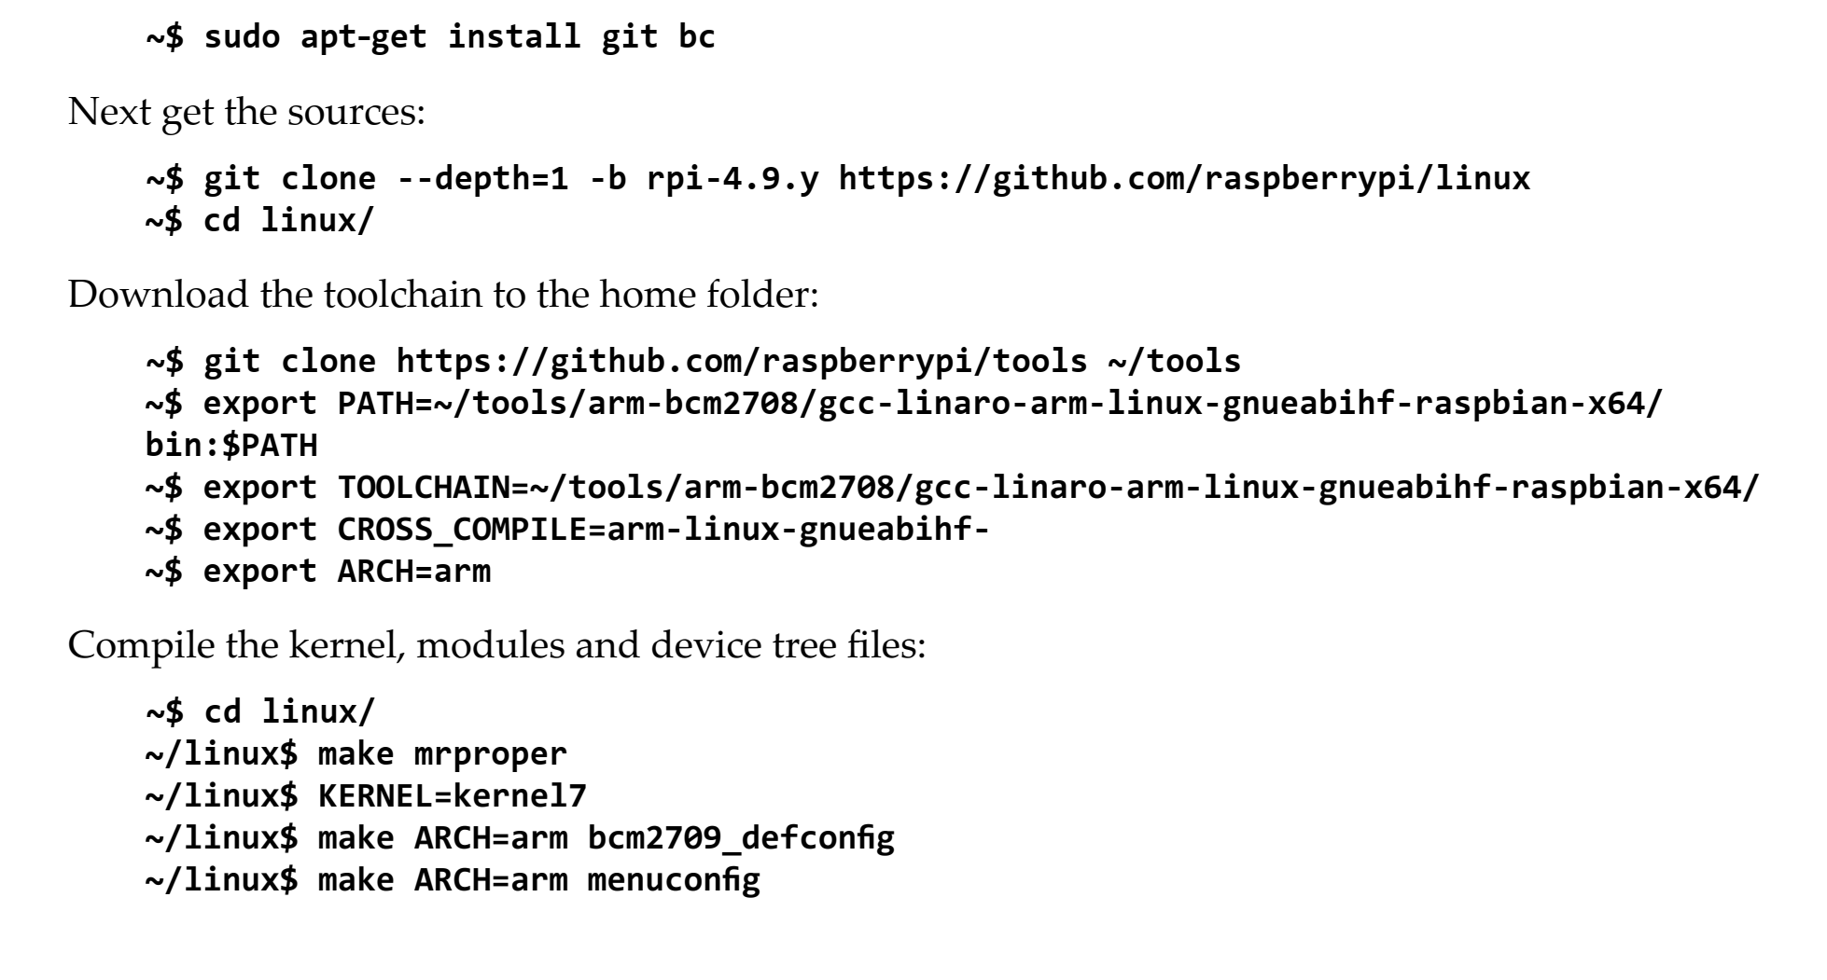
Building the Linux Kernel
There are two main methods for building the kernel. You can build locally on a Raspberry Pi, which will take a long time; or you can cross-compile, which is much quicker, but requires more setup. You will use the second method. First install Git and the build dependencies

Slide 24
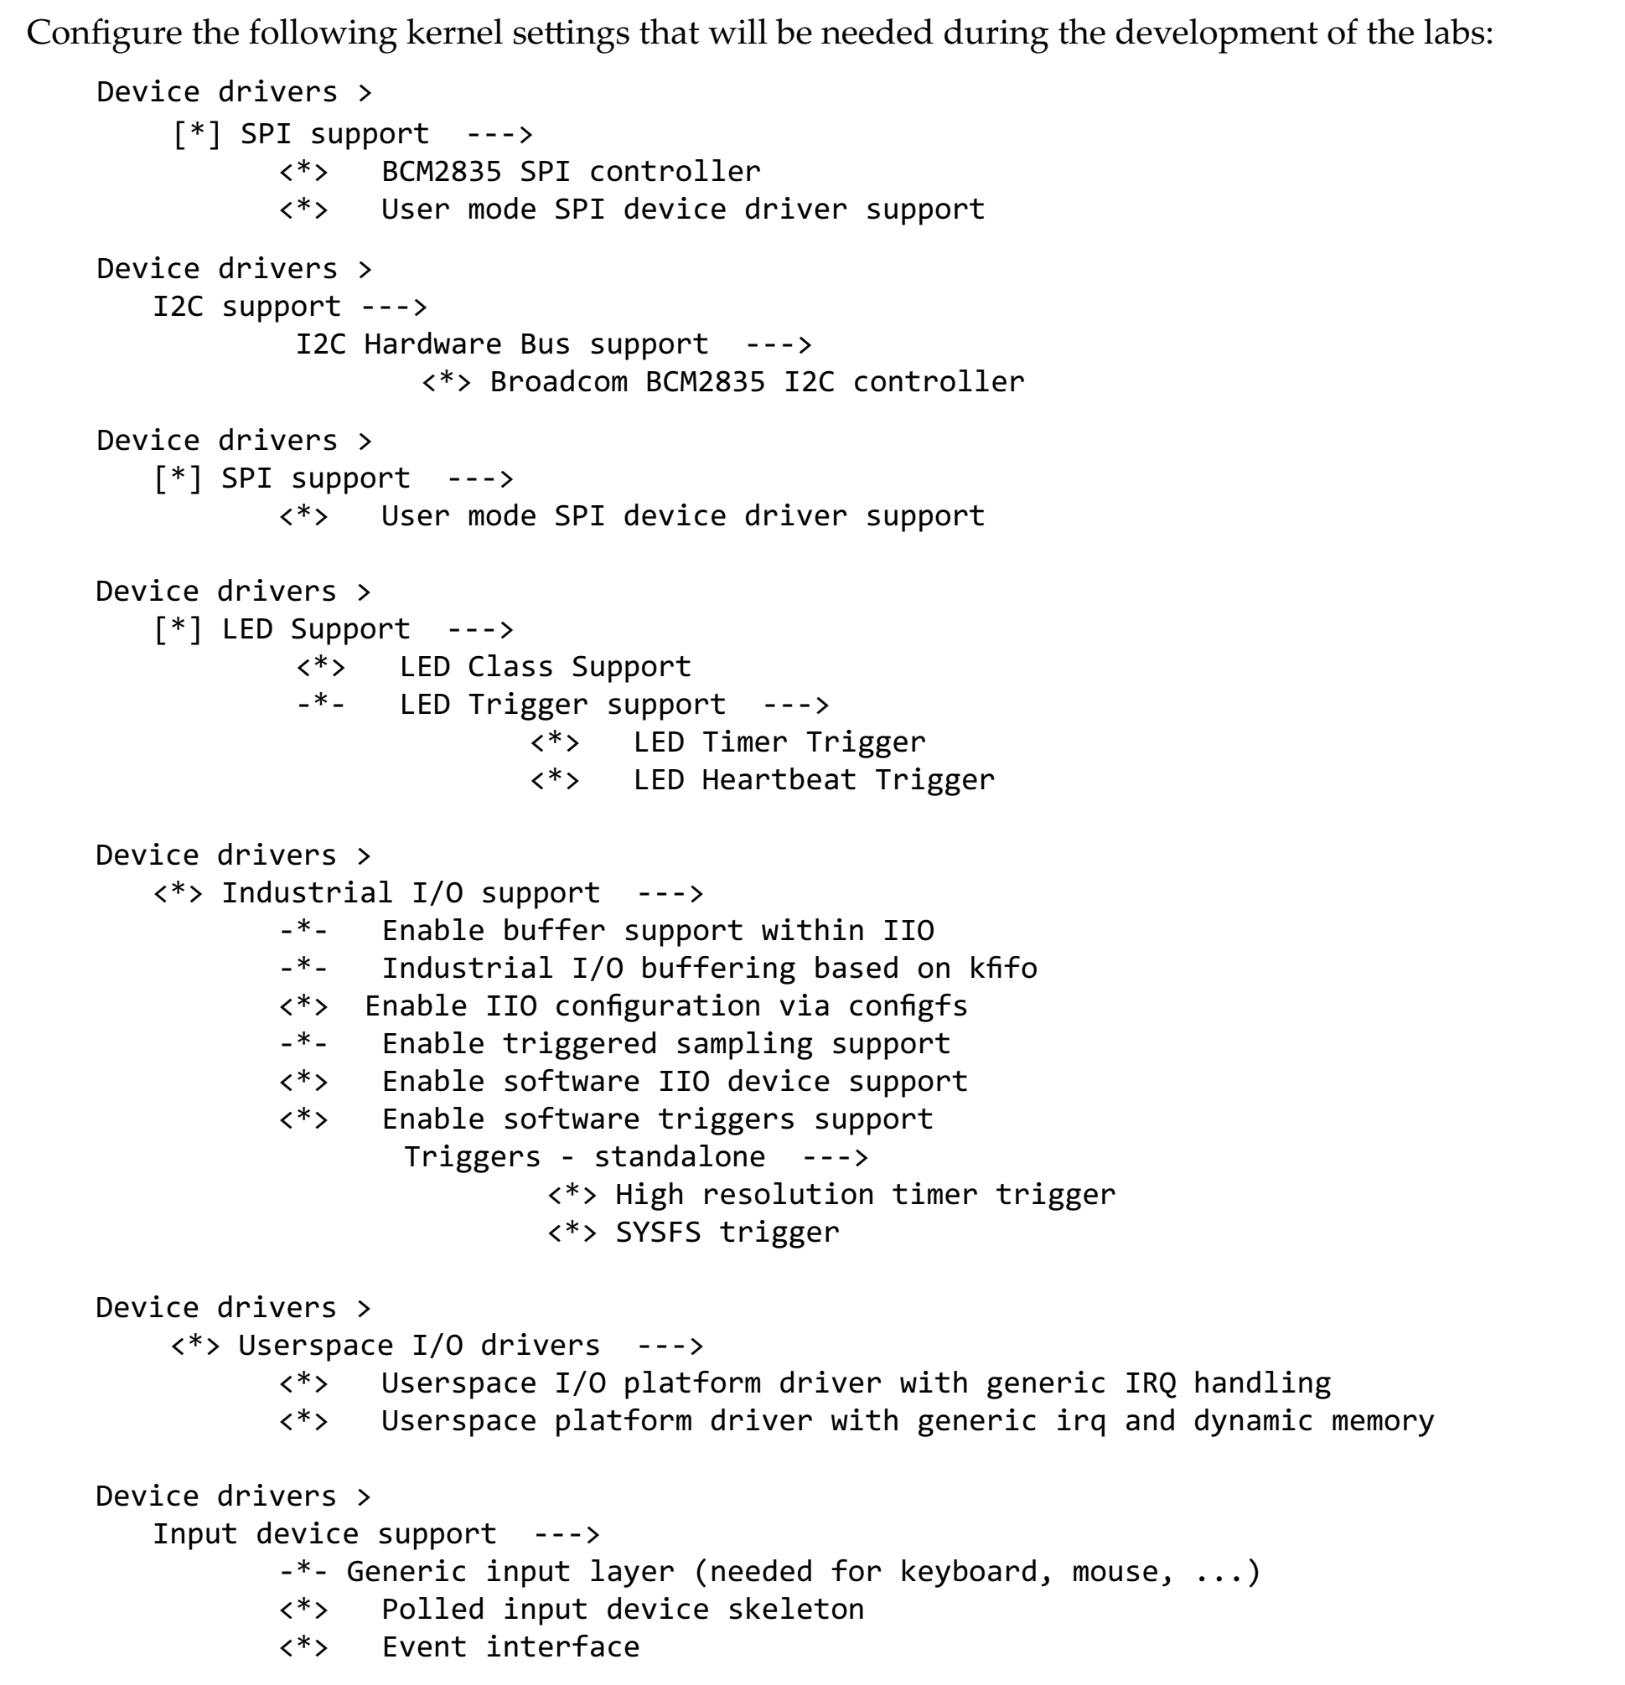

Slide 25
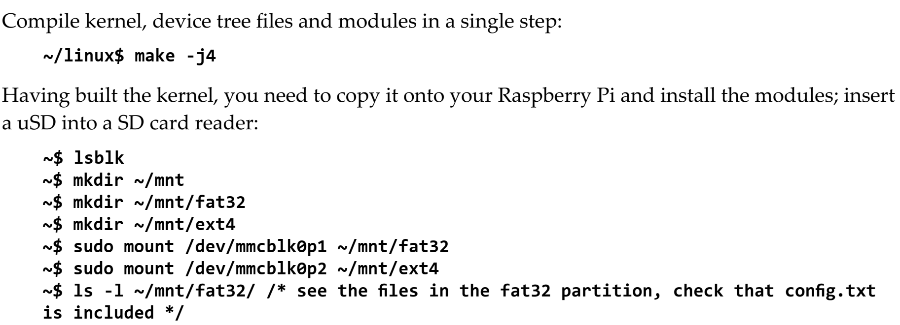

Slide 26
